Slide 1
Part III
Elementary Statistical Methods
Probability

Slide 2
Elementary Statistical Methods
Chapter 4
Probability
Slides are Made by
Tamer Oraby
UTRGV

Slide 3
Outline:
Random Experiment - Sample Space - Event – Probability.
Some types of events: rare event, impossible event, sure event, mutually exclusive events, independent events.
Rules of probability: 1) complement rule – 2) addition rule – 3) general addition rule – 4) multiplication rule and independence.
Conditional probability and general multiplication rule.

Slide 4
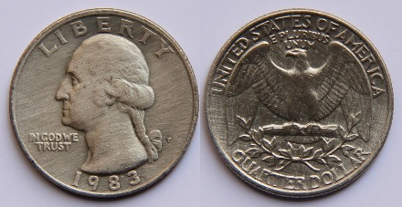
Random experiment
is an experiment where the outcomes are known in advance but we cannot tell which one will occur next time we carry out the experiment.
Head (H)
Tail (T)
Sample space ( S )
is the set of all possible outcomes.
S={H , T}
S={1,2,3,4,5,6}

Slide 5
Event ( A, B, C,…)
is a subset of the sample space S.
Sample space S
Event A
Probability
is a measure of the likelihood or the chance that event takes place.
n(S) is the number of elements in S or
number of ways S is performed.

Slide 6
Example :
S={H , T}
Flip a coin
Let A be the event of a head appears
Probability of A is
Example :
S={1,2,3,4,5,6}
Roll fair die once
(a) What is the probability of obtaining an even number ?
(b) What is the probability of obtaining a number more than 4?

Slide 7
Remarks:
The probability that any one of the outcomes of a random experiment will appear, which is the event S
We call S sure event
The probability that nothing will show up when you carry out a random experiment, which is the event $∅$={} (pronounced phi)
We call $∅$ impossible event
Definition:
An event $A$ is said to be rare, unlikely, unusual or improbable if
$$P\left(A\right)<.05$$

Slide 8
Example: A box contains 3 red balls, 3 black balls and 4 blue balls.
If a ball is selected at random, find the probability that:
It is blue
It is white.
It is red.
P(Blue)=4/10=.4
P(White)=0/10=0
P(Red)=3/10=.3

Slide 9
Example: If a card is selected at random from a deck of 52 playing
cards.

Slide 10
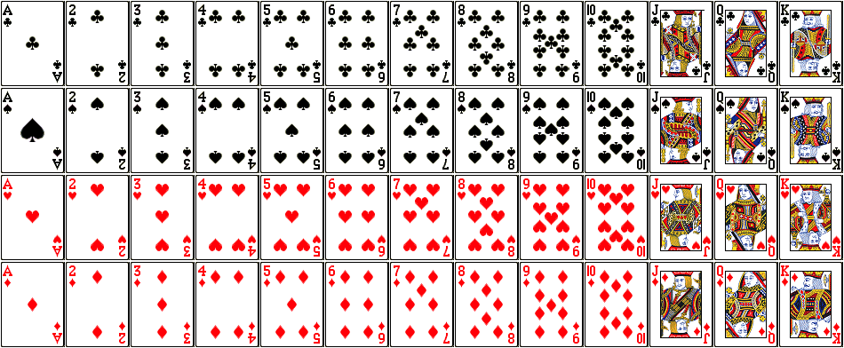
Ace | Two | Three | Four | Five | Six | Seven | Eight | Nine | Ten | Jack | Queen | King
Club
Spade
Heart
Diamond

Slide 11
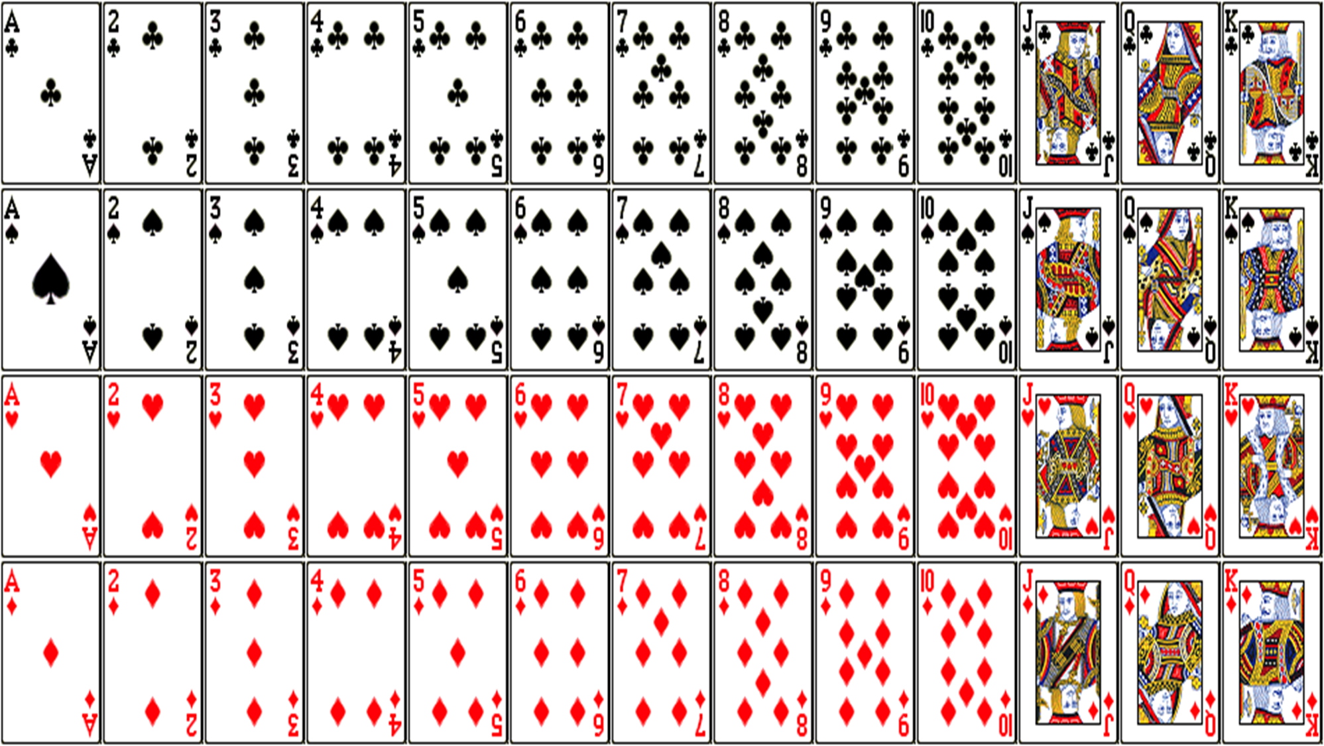
Example: If a card is selected at random from a deck of 52 playing cards. Find,
The probability that it is a red-colored card.
The probability that it is a Heart.
The probability that it is a Queen card.
The probability that it is a red-colored Queen card.
P(Red)=26/52=1/2
P(Heart)=13/52=1/4
P(Queen)=4/52=1/13
P(Red Queen)=2/52=1/26 = .038

Slide 12
Example :
A box contains 19 blue sticks and one red stick. One
stick is selected at random.
Assume that the sticks are “equally likely” to be selected.
What is the probability that stick has a blue color?
The probability that stick is blue
P( = ) = $\frac{19}{20}=.95$

Slide 13
Some operations on events:
Venn diagrams
are used to visualize some events and operations on them.
S
A^{c}
A^{c}: A complement
( not A)
A
Example:
If S={1,2,3,4,5,6} and A={1,2,3,4}
Then A^{c} ={5,6}

Slide 14
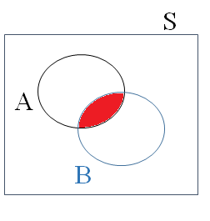
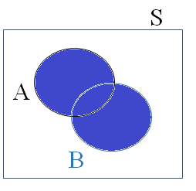
Some operations on events:
A and B
A or B
(both A and B)
(either A or B)
Example :
Example :
If A={1,2,3,4}
and B={1,3,5}
Then A and B={1,3}
If A={1,2,3,4}
and B={1,3,5}
Then A or B={1,2,3,4,5}

Slide 15
Example :
S={HH, HT, TH, TT}
Flip a coin twice
(a) What is the probability that exactly one tail ( T ) appears?
A: Exactly one tail ( T ) appears
(b) What is the probability that at least one tail will appear ?
B: at least one tail will appear

Slide 16
S={HH, HT, TH, TT}
(c) What is the probability that the second toss is head?
C: the second toss is head
A
(d) What is the probability that exactly one tail ( T ) appears and the second toss is head?
Remember:
A: Exactly one tail appears
$$A=\{HT,TH\}$$
C

Slide 17
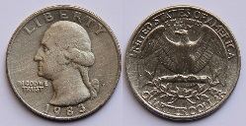
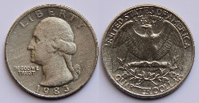
Example :
Flip a coin three times
S={HHH, HHT, HTH, THH, TTH, THT, HTT, TTT}
(a) What is the probability that exactly two heads appear?
A: exactly two heads appear
(b) What is the probability that exactly three heads appear ?
B: exactly three heads appear

Slide 18
Example :
Cast two distinguishable dice once
(a) What is the probability that the sum of the two faces of the dice is 10?
A: the sum of the two faces of the dice is 10

Slide 19
(b) What is the probability that the first is three and the second is more than four?
B: the first is three and the second is more than four
Remember:
A: the sum of the two
faces of the dice is 10
$$A=\{(4,6),(5,5),(6,4)\}$$
(c) What is the probability of $A and B$?
$$A and B=\left\{ \right\}=∅$$
the impossible event

Slide 20
(d) What is the probability that the difference between the second and the first face is three?
C: the difference between the second and the first face is three

Slide 21
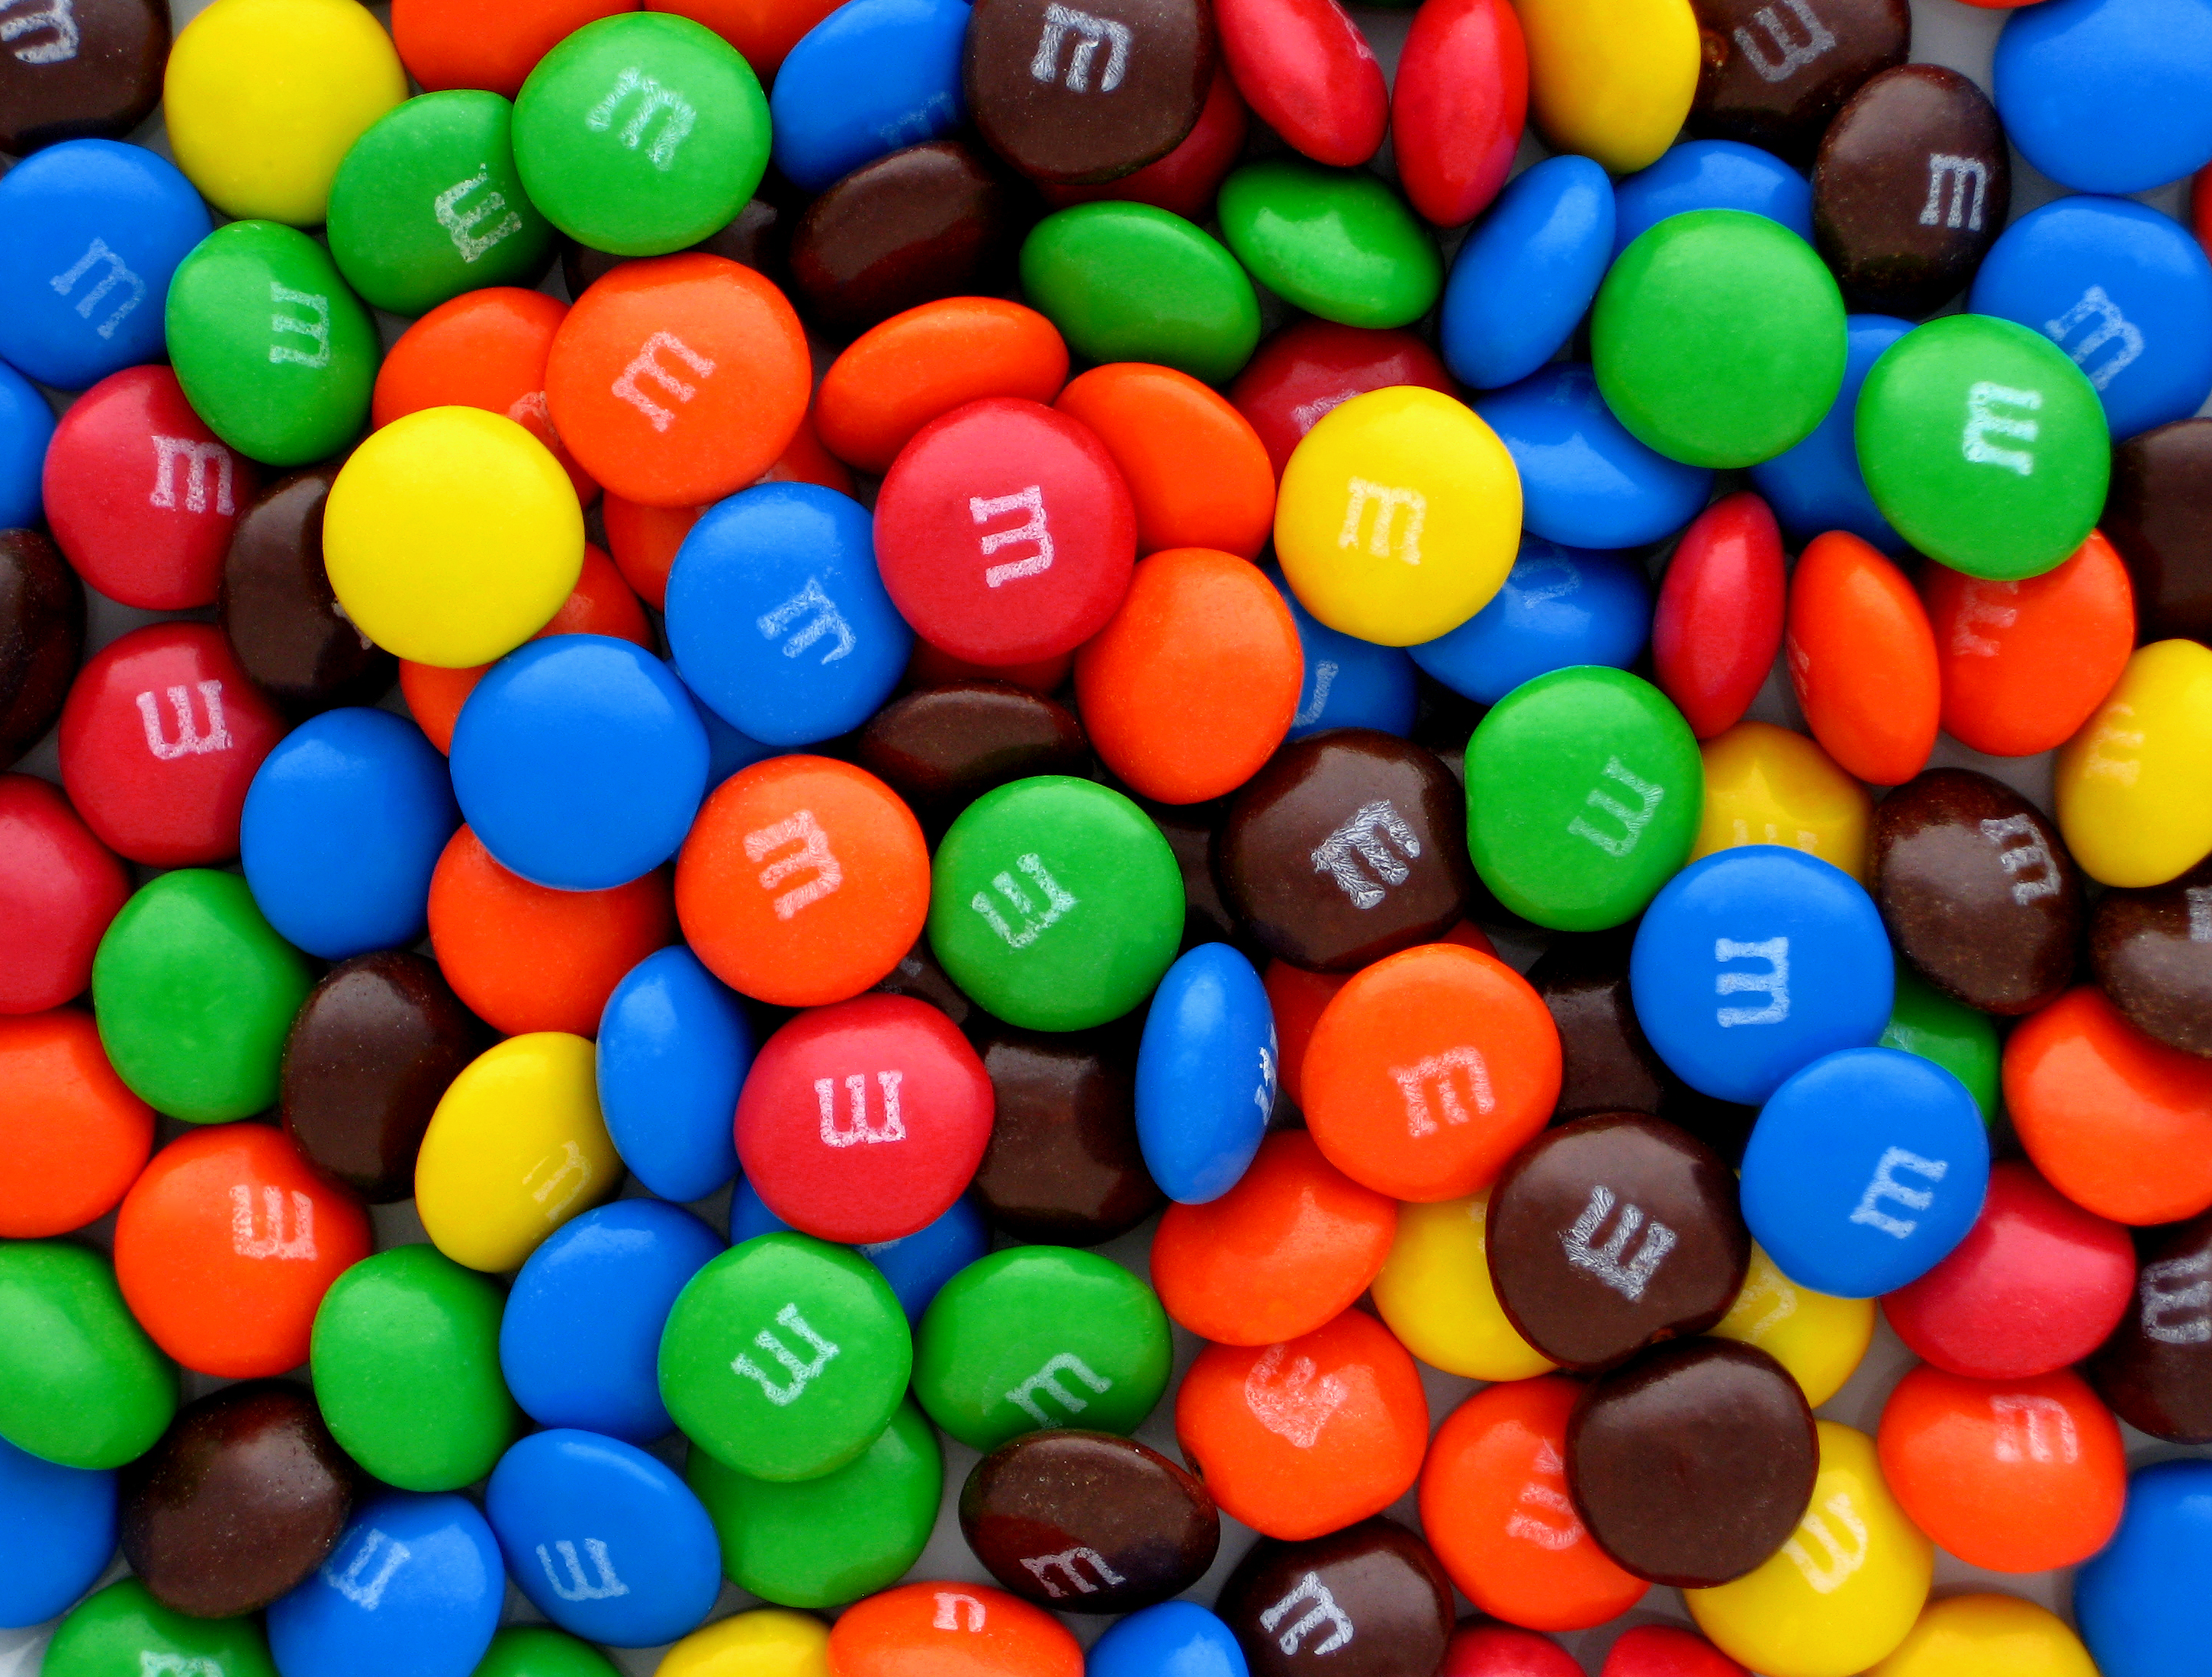
Example :
Select one M&M at random from a bag that contains
M&M | Count (or Frequency) | Relative frequency
Brown | 10 | 10/60
Yellow | 12 | 12/60
Red | 18 | 18/60
Blue | 10 | 10/60
Green | 10 | 10/60
Total | 60 | 1
This table
is called
a probability model
since all probabilities
are between 0 and 1
and they add up to 1.
(a) What is the probability that it is Yellow?

Slide 22
(b) What is the probability that it is Yellow or Brown?
P(Yellow or Brown) = $\frac{12+10}{60}=\frac{22}{60}=\frac{11}{30}$
OR
(c) What is the probability that it is Orange?
M&M | Count (or Frequency) | Relative frequency
Brown | 10 | 10/60
Yellow | 12 | 12/60
Red | 18 | 18/60
Blue | 10 | 10/60
Green | 10 | 10/60
Total | 60 | 1
(d) What is the probability that it is not Green?
P(not Green) = $\frac{50}{60}=\frac{5}{6}$
OR
P(not Green) = $1−\frac{10}{60}=\frac{5}{6}$

Slide 23
Section 1 Probability rules
1. Complement Rule
Probability that A will not occur is given by
S
P(A^{c}) = 1 – P(A)
A^{c}
A^{c}: A complement
( not A)
A
Example :
If P(A) = 0.9. Find P(A^{c})?
P(A^{c}) = 1 – P(A) = 1 – 0.9 = 0.1

Slide 24
Example :
If a letter is selected at random from the alphabets.
a) What is the probability that the selected letter is a vowel?
S
V: Vowels in alphabets
V={a, e, i, o, u}
b
c
h
j
p
u
o
i
d
n
e
a
f
g
k
r
s
v
l
m
q
b) What is the probability that the selected letter is
not a vowel?
x
w
t
z
y
P$\left(V^{c}\right)=\frac{number of consonants}{26}=\frac{21}{26}$
Or by the complement rule

Slide 25
Section 2 Addition Rules
S
We say that A and B are mutually exclusive events if A and B cannot happen at the same time and place.
A
1. Addition Rule
B
If A and B are disjoint (or mutually exclusive), then
$$A and B=\left\{ \right\}=∅$$
P( A and B) = 0
Example for two disjoint events:
A: it is snowing
B: the temperature is 90◦ F
A and B cannot happen
at the same time and same place
A and B={ }
Example :
Let A and B be two mutually exclusive events such that
Then

Slide 26
In general
If A₁, A₂, A₃, …, A_{n} are disjoint (or mutually exclusive), then
$P(A_{1} or A_{2}$ or $A_{3}$ or … or $A_{n})=P\left(A_{1}\right)+$ $P\left(A_{2}\right)+$ $P\left(A_{3}\right)+…+$ $P\left(A_{n}\right)$
Example :
Let A, B, and C be three mutually exclusive events such that
Find P(A or B or C).

Slide 27
2. General Addition Rule
S
If A and B have general relationship
A
Example :
Let A and B be any two events such that
B
Are A and B mutually exclusive?
No, since $P(A and B)≠0$
Find the probability of either A or B.
Find the probability of neither A nor B.

Slide 28
Example :
If 45% of UTRGV students take elementary statistics (call it E), 25% of UTRGV students take calculus I (call it C) and 10% of UTRGV students take both.
(a) What is the probability that a randomly selected student has taken at least one of them?
(b) What is the probability that a randomly selected student has taken neither one?

Slide 29
Section 3 Independence and multiplication rules
We say that A and B are independent events if occurrence of A doesn’t affect the probability (chances) of B’s occurrence.
S
1. Multiplication Rule
A
A and B are independent events if and only if
B
Example :
Let
and
Are A and B mutually exclusive?
Are A and B two independent events ?
No, since $P(A and B)≠0$
Answer is Yes

Slide 30
Example :
Let
Are A and B mutually exclusive?
and P(A and B) = 0.15
Are A and B two independent events ?
No, since $P(A and B)≠0$
Answer is No
Example :
If A and B are two independent events; such that
(a) Find P(A and B) and name the rule?
by Multiplication rule
(b) Find P(A or B) and name the rule?
by General addition rule

Slide 31
Example :
Suppose that events E and F are independent, $P(E)=0.3$and $P(F)=0.6$. What is the $P(E or F)$?
$P\left(E or F\right)=$ $P\left(E\right)+P\left(F\right)− P\left(E and F\right)$
$$=P\left(E\right)+P\left(F\right)−P\left(E\right)∗P\left(F\right)$$
$$= .3 + .6 − .3 ∗ .6 =.72$$

Slide 32
In general
If A₁, A₂, A₃, …, A_{n} are independent events, then
$P(A_{1} and A_{2}$ and $A_{3}$ and … and $A_{n})=P\left(A_{1}\right)∗$ $P\left(A_{2}\right)∗$ $P\left(A_{3}\right)∗…∗$ $P\left(A_{n}\right)$
Example :
Let A, B, and C be three independent events such that
Find P(A and B and C).

Slide 33
Example :
Bowling: Suppose that Ralph gets a strike when bowling 30% of the time.
(a) What is the probability that Ralph gets two strikes in row?
$$P\left(two strikes in a row\right)=P(strike and strike) = .3∗.3={.3}^{2}=0.09$$
(b) What is the probability that Ralph gets a turkey (three strikes in row)?
$$P\left(turkey\right)=P(strike and strike and strike)=.3∗.3∗ .3={.3}^{3}=0.027$$
(c) When events are independent, their complements are independent as well. Use this result to determine the probability that Ralph gets a turkey but fails to get a clover (four strikes in a row) ?
$$P\left(3 strikes followed by nonstrike\right)=$$
$$P\left(strike and strike and strike and nonstrike\right)=$$
$$.3∗.3∗ .3∗\left(1−.3\right)=.027∗.7=.0189$$

Slide 34
Example :
Life Expectancy The probability that a randomly selected 40-year-old male will live to be 41 years old is 0.99757, according to the National Vital Statistics.
(a) What is the probability that two randomly selected 40-year-old male will live to be 41 years old ?
P(two males will live to 41 years) = (0.99757)² = 0.99515
(b) What is the probability that five randomly selected 40-year-old male will live to be 41 years old ?
P(five males will live to 41 years) = (0.99757)⁵ = 0.98791

Slide 35
2. Conditional Probability
Probability of A given B is the probability that A occurs given that event B has occurred. It is denoted by P(A|B).
S
A and B
A
B
; if P(B) > 0
; if P(A) > 0

Slide 36
Example :
If
Find P(A|B) and P(B|A).
Remark :
If A and B are independent, then

Slide 37
Example:
If 100 students were surveyed for their major and the numbers are given in the following two-way frequency table:
Gender\Major | Biology (B) | Math (M) | Nursing (N) | Total
Female (F) | 17 | 4 | 39 | 60
Male (M) | 18 | 6 | 16 | 40
Total | 35 | 10 | 55 | 100
If one student is selected at random from that group of students.
What is the probability that the student is female?
P(F)=60/100=0.6
What is the probability that student is majoring in nursing?
P(N)=55/100=0.55
3) What is the probability that the student is a female who has a nursing major?
P(F and N)=39/100=0.39

Slide 38
Gender\Major | Biology (B) | Math (M) | Nursing (N) | Total
Female (F) | 17 | 4 | 39 | 60
Male (M) | 18 | 6 | 16 | 40
Total | 35 | 10 | 55 | 100
If one student is selected at random from that group of students.
If the student that was selected at random is a female, what is the probability that she is majoring in nursing?
P(N|F)=39/60=.65
I the student that was selected at random is majoring in nursing, what is the probability that the student is a female?
P(F|N)=39/55=.71

Slide 39
3. General Multiplication Rule
S
A and B have general relationship
$P(A \text{and} B)=P(A)∗P(B|A)$
&
A
$P(A \text{and} B)=P(B)∗P(A|B)$
B
Example :
Let $P\left(A\right)=\text{0.1}, P\left(B\right)=\text{0.5}\text{, }and P(A \text{|} B)=0.01$.
1) Are A and B two independent events?
$$P\left(A\right)=0.1 ≠0.01=P(A \text{|} B)$$
Answer is No
1) Find P(A and B).
$P\left(A and B\right)=P\left(B\right)∗P\left(A \right| B)$=0.5 $∗$ 0.01=0.005.

Slide 40
Example: A box contains 3 red balls, 3 black balls and 4 blue balls.
If two balls are selected at random with replacement,
find the probability that:
Both are blue
The first is blue and the second is red
The first is red and the second is black
$$P(B1 and B2)=P(B1)∗P(B2)=(\frac{4}{10})∗(\frac{4}{10})=.16$$
$$P(B1 and R2)=P(B1)∗P(R2)=(\frac{4}{10})∗(\frac{3}{10})=.12$$
$$P(R1 and Bk2)=P(R1)∗P(Bk2)=(\frac{3}{10})∗(\frac{3}{10})=.09$$

Slide 41
Example: A box contains 3 red balls, 3 black balls and 4 blue balls.
If two balls are selected at random without replacement,
find the probability that:
Both are blue
The first is blue and the second is red
The first is red and the second is black
$$P(B1 and B2)=P(B1)∗P(B2|B1)=(\frac{4}{10})∗(\frac{3}{9})=.13$$
$$P(B1 and R2)=P(B1)∗P(R2|B1)=(\frac{4}{10})∗(\frac{3}{9})=.13$$
$$P(R1 and Bk2)=P(R1)∗P(Bk2|R1)=(\frac{3}{10})∗(\frac{3}{9})=.1$$

Slide 42
In general
If A₁, A₂, A₃, …, A_{n} are any n events, then
$P(A_{1} and A_{2}$ and $A_{3}$ and … and $A_{n})=P\left(A_{1}\right)∗$ $P\left(A_{2}|A_{1}\right)∗$ $P\left(A_{3}|A_{1} and A_{2}\right)∗ P\left(A_{4}|A_{1} and A_{2} and A_{3}\right)∗…∗$ $P\left(A_{n}|A_{1} and A_{2} \text{and} A_{3} \text{and}\text{ … }\text{and} A_{n−1}\right)$
Example :
Let A, B, and C be and three events such that
$$P(A)=\text{0.}\text{2}$$
$$P(B|A)=\text{0.}\text{1}$$
$$P\left(C\right|A and B)=\text{0.0}\text{5}$$
Find P(A and B and C).
$P(A and B$and $C)=P\left(A\right)∗$ $P\left(B|A\right)∗$ $P\left(C|A and B\right)=.2∗.1∗.05=.001$

Slide 43
Example: If three cards are selected at random from a deck of 52 playing cards without replacement. Find,
The probability that they are two Jack and one Queen.
The probability that they are two red colored cards and one club shape.
The probability that that they are one heart and two diamond shape.

Slide 44
End of Chapter 4

